Slide 1
R
Probability Concepts

Slide 2
Types
Important ones
Normal Distribution
Binomial Distribution
Poisson Distribution
Chi-Square Distribution
Many more actually.

Slide 3
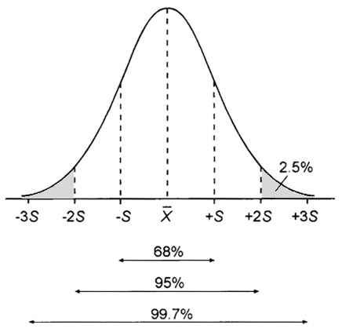
R Normal Distribution

Slide 4
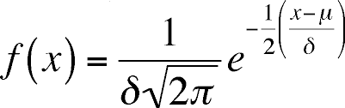
The normal distribution is defined by the following probability density function,
where μ is the population mean and
σ² is the variance.

Slide 5
Z scores
Z-scores are a stand-in for the actual measurement, and they represent the distance of a value from the mean measured in standard deviations.
So a z-score of 2.0 means the measurement is 2 standard deviations away from the mean.

Slide 6
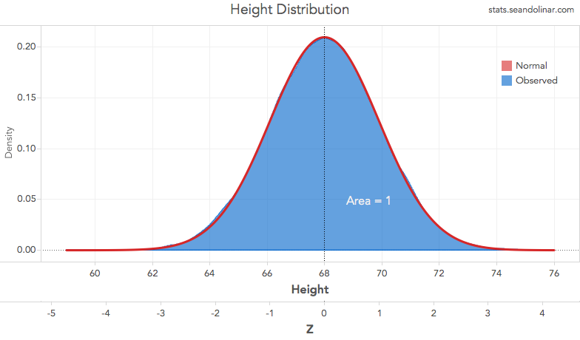
Z score ( height and Z)

Slide 7
The first step to find the z-score is to find the population mean and standard deviation.
Mean, stddev
Using just the population mean [μ = 67.99] and standard deviation [σ = 1.90], you can calculate the z-score for any given value of x. In this example I’ll use 72 for x.

Slide 8
#Using just the population mean [μ = 67.99] and standard deviation [σ = 1.90],
# you can calculate the z-score for any given value of x. In this example I’ll use 72 for x.
pop_mean = 67.99
pop_sd =1.90
x = 72
z <- (x - pop_mean) / pop_sd
print(paste("Z score", round(z,3)))

Slide 9
p > 72 inches
This gives you a z-score of 2.107. To put this tool to use, let’s use the z-score to find the probability of finding someone who is 72 inches [6-foot] tall.

Slide 10
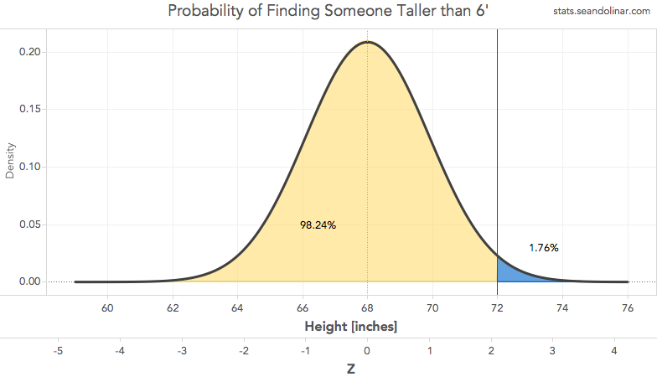
p > 72

Slide 11
p_yellow1 <- pnorm(72, pop_mean, pop_sd) #using x, mu, and sigma
p_yellow2 <- pnorm(z) #using z-score of 2.107
p_blue1 <- 1 - p_yellow1 #using x, mu, and sigma
p_blue2 <- 1 - p_yellow2 #using z-score of 2.107
print(p_yellow1)
print(p_yellow2)
print(p_blue1)
print(p_blue2)

Slide 12
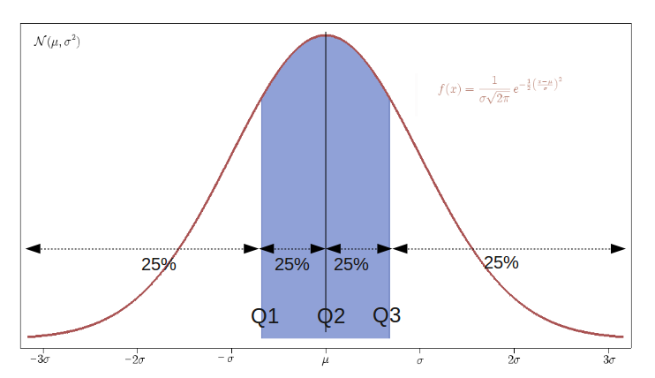

Slide 13
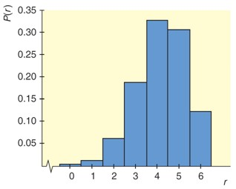
Binomial
X axis =r versus p(r) on y axis

Slide 14
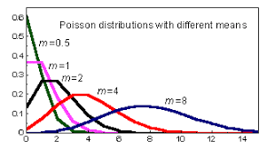
Poisson

Slide 15
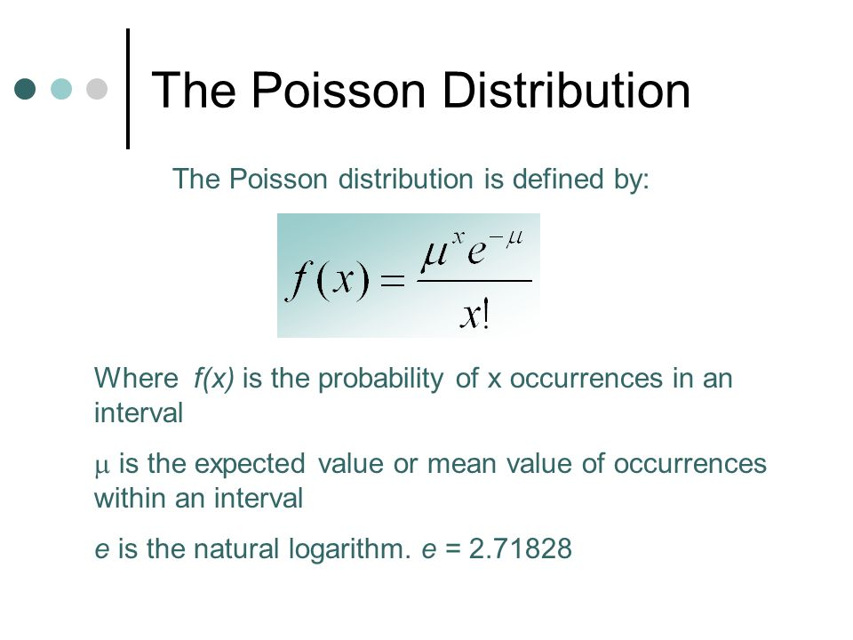

Slide 16
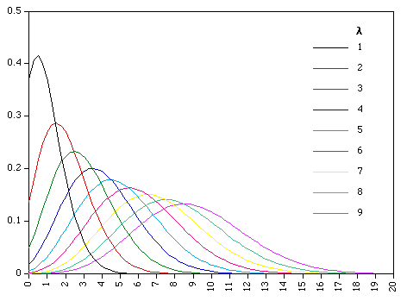
Poisson

Slide 17
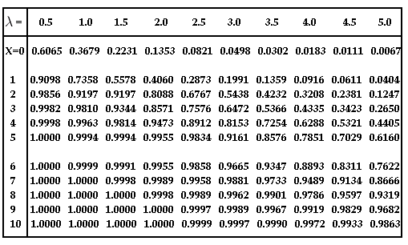
POISSON DISTRIBUTION TABLE

Slide 18
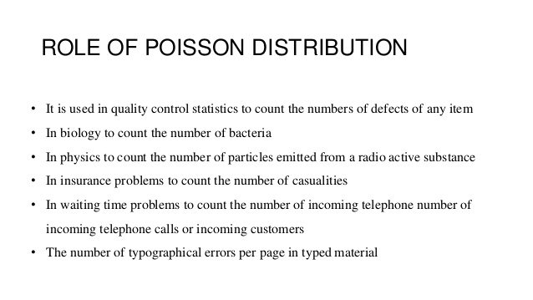

Slide 19
Usage
dpois(x, lambda, log = FALSE)
ppois(q, lambda, lower.tail = TRUE, log.p = FALSE)
qpois(p, lambda, lower.tail = TRUE, log.p = FALSE)
rpois(n, lambda)

Slide 20
Problem
Problem
If there are twelve cars crossing a bridge per minute on average, find the probability of having seventeen or more cars crossing the bridge in a particular minute.
ppois(16, lambda=12) # lower tail
The probability of having sixteen or less cars crossing the bridge in a particular minute is given by the function ppois.
ppois(16, lambda=12, lower=FALSE) # upper tail
Hence the probability of having seventeen or more cars crossing the bridge in a minute is in the upper tail of the probability density function.

Slide 21
Where the rate of occurrence of some event, r (in this chart called lambda) is small, the range of likely possibilities will lie near the zero line

Slide 22
binomial distribution
The binomial distribution is a discrete probability distribution. It describes the outcome of n indep
Each trial is assumed to have only two outcomes, either success or failure.
If the probability of a successful trial is p, then the probability of having x successful outcomes in an experiment of n independent trials is as follows.
P,x,n

Slide 23
Problem
Suppose there are twelve multiple choice questions in an English class quiz. Each question has five possible answers, and only one of them is correct. Find the probability of having four or less correct answers if a student attempts to answer every question at random.
Solution
Since only one out of five possible answers is correct, the probability of answering a question correctly by random is 1/5=0.2. We can find the probability of having exactly 4 correct answers by random attempts as follows.

Slide 24
##
dbinom(4, size=12, prob=0.2)
> dbinom(0, size=12, prob=0.2) + + dbinom(1, size=12, prob=0.2) + + dbinom(2, size=12, prob=0.2) + + dbinom(3, size=12, prob=0.2) + + dbinom(4, size=12, prob=0.2) [1] 0.9274
For this – Cumulative
pbinom(4, size=12, prob=0.2)
Answer
The probability of four or less questions answered correctly by random in a twelve question multiple choice quiz is 92.7%.

Slide 25
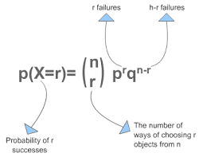
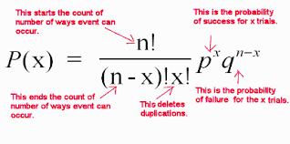
Binomial formula

